Slide 1
The Active Directory Botnet
Ty Miller
Managing Director
Threat Intelligence Pty Ltd
ty.miller@threatintelligence.com
www.threatintelligence.com
Paul Kalinin
Senior Security Consultant
Threat Intelligence Pty Ltd
paul.kalinin@threatintelligence.com
www.threatintelligence.com

Slide 2
Introduction

Slide 3
Who are we?
Ty Miller
Managing Director, Threat Intelligence Pty Ltd (www.threatintelligence.com)
Specialist Security Company based in Australia
CREST Australia New Zealand (Board of Directors, Technical Team Lead, Assessor)
Security Researcher, Penetration Tester, Presenter and Trainer
Black Hat Black Hat Asia Review Board
Black Hat Training The Shellcode Lab
Black Hat Training Practical Threat Intelligence
Black Hat Presentation Reverse DNS Tunneling Shellcode
Black Hat Presentation The Active Directory Botnet
Black Hat Webcast The Best Way to Catch a Thief
Core Impact: DNS Channel Payload
Development and Presentation BeEF Bind Shellcode
Co-Author Hacking Exposed Linux 3rd Edition
Presentation Machine Learning and Modern Malware Mitigations
Presentation Modern Threat Detection and Prevention
Presentation Securing Your Startup to Secure Big Brands
Presentation Can your application be breached?

Slide 4
Who are we?
Paul Kalinin
Senior Security Consultant, Threat Intelligence Pty Ltd (www.threatintelligence.com)
Certs: CREST, CEH, CISSP, PCI QSA
Penetration Tester, Security Specialist and Security Researcher
Black Hat Training Practical Threat Intelligence
Black Hat Presentation The Active Directory Botnet
Specialty Internal Infrastructure and Wireless Penetration Testing
Specialty Red Team Penetration Testing
Specialty Web and Mobile Penetration Testing
Specialty Cyber Threat Intelligence Analyst
Specialty Attack Design, Development and Weaponization
Specialty Security Architecture and Governance

Slide 5
What are we talking about?
We are going to demonstrate how to exploit a fundamental flaw in the way that nearly every organization implements their Active Directory solution
This attack technique introduces a gaping hole within your internal and hybrid-cloud security architectures that impacts your ability to contain security breaches
This is achieved by turning your Active Directory solution into an internal Botnet Command & Control cluster
Demonstrate the capability to bypass your internal firewalls and network segmentation to communicate with all internal hosts
Remotely control and exfiltrate data via the AD Botnet

Slide 6
Current State of Play

Slide 7
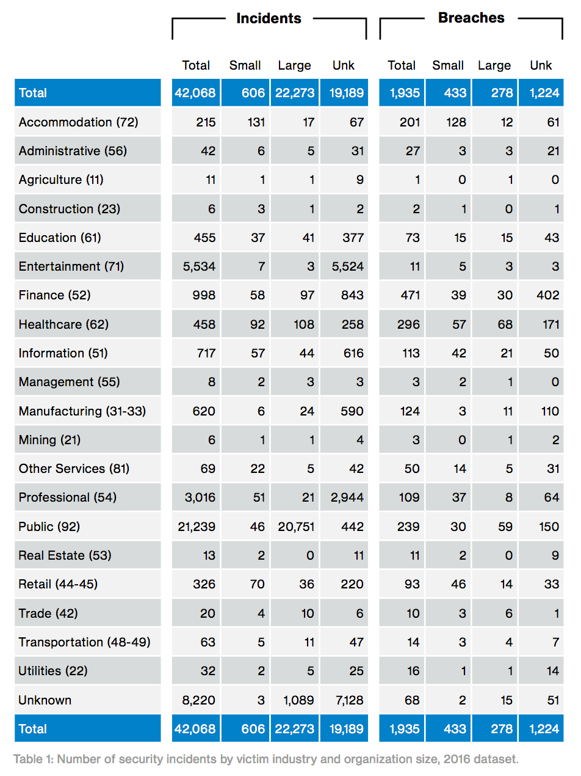
Threat Actors are Winning
* Verizon 2017 Data Breach Investigations Report - 10th Edition
Notes:
The Verizon 2017 Data Breach Investigations Report:
- Demonstrates that every industry is being attacked, and every industry is suffering security breaches

Slide 8
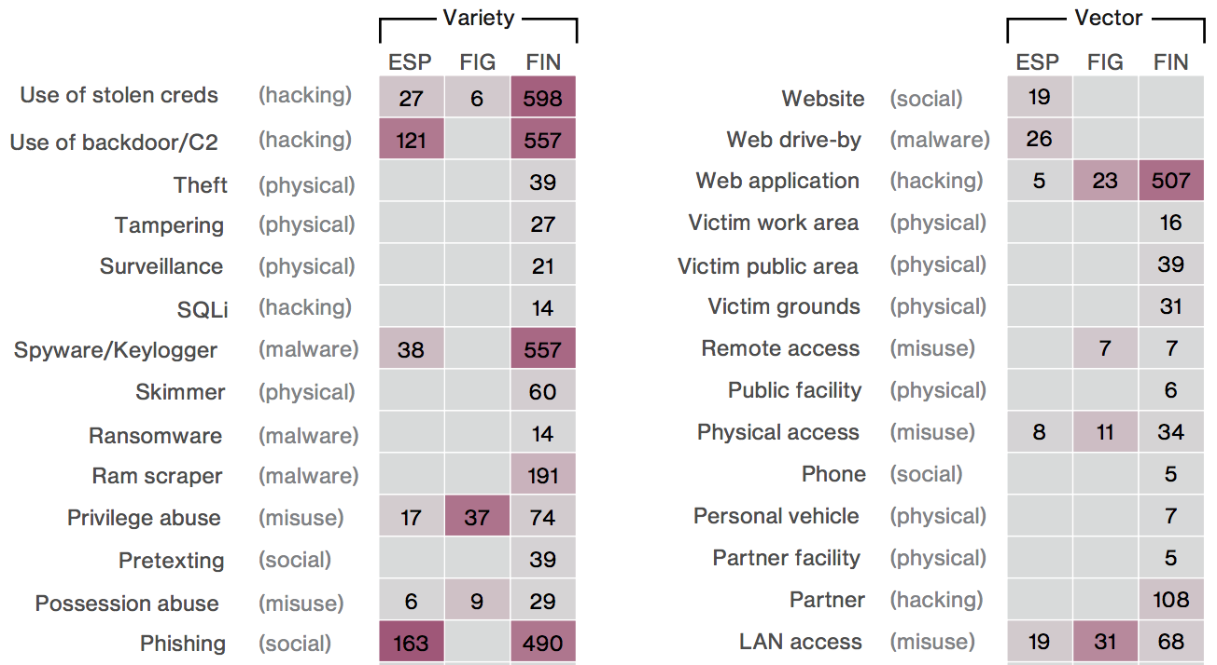
Financially Motivated Attackers
* Verizon 2017 Data Breach Investigations Report - 10th Edition
Notes:
Attackers are highly motivated with focus on Financial Gains
FIN = financial motivation of attackers is the primary objective

Slide 9
Ransomware Revenue
* csoonline.com article “Ransomware took in $1 billion in 2016”
Notes:
Estimated $1 Billion of ransomware payments last year:
Locky $120 million
Cryptowall $100 million
CryptXXX $73 million (6 months)
Cerber $54 million
Smaller families $150 million
FBI reported $209 million (3 months)

Slide 10
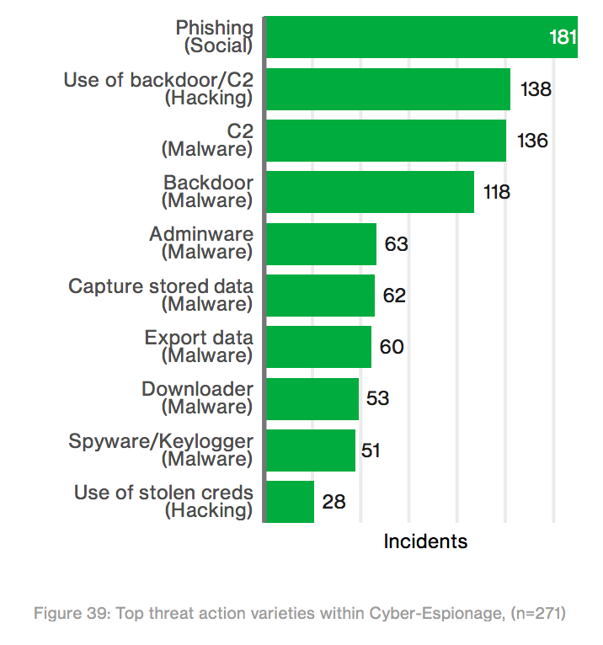
Primary Attack Techniques
Command & Control (C2) systems are key to modern security breaches
“phishing remaining a favorite technique of attackers … payloads are commonly delivered via email (73%) and drive-by downloads (13%)”
“If the attachment is opened, it will drop command and control malware to establish and maintain control of the device”
* Verizon 2017 Data Breach Investigations Report - 10th Edition
Notes:
Hacking backdoors use C2, and malware uses C2, with most common delivery technique by far being phishing

Slide 11
Attack Capabilities
Currently attackers are still trying to be stealthy … but for how long?
Open Source technologies have enabled attacks to have the capability to become highly sophisticated
Cloud platforms are extending internal networks out to the internet, and often introducing significant security weaknesses and removing visibility of threats
Huge potential for attacks to turn noisy for Fast Escalation and Large Impact attacks
Harder to recover from … Lead to increased revenue stream for attackers

Slide 12
Current State of Play
Highly motivated Threat Actors
utilizing endpoint exploitation techniques
that connect to Command & Control (C2) servers
to launch fast and effective internal attacks
The main challenge is to reliably connect out to the internet-based C2 servers

Slide 13
But what if … ?
What if the C2 servers exist inside your internal network?
What if the C2 servers exist as a part of your critical infrastructure?
What if the C2 servers use your production services for communication?
What if the C2 servers can bypass your internal firewalls and network segmentation to communicate with all hosts?
What if the C2 servers can communicate with remote attackers using your production cloud?

Slide 14
The Active Directory Botnet

Slide 15
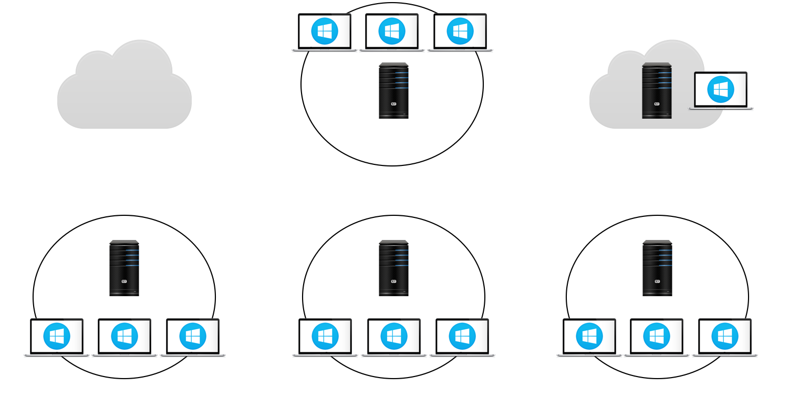
Common Architecture: Active Directory
DMZ
Servers
Cloud DC
Domain
Controller
WAN 1
WAN 2
Endpoints
Servers
Management Zone
Notes:
AD components
AD functional requirements
AD architectures

Slide 16
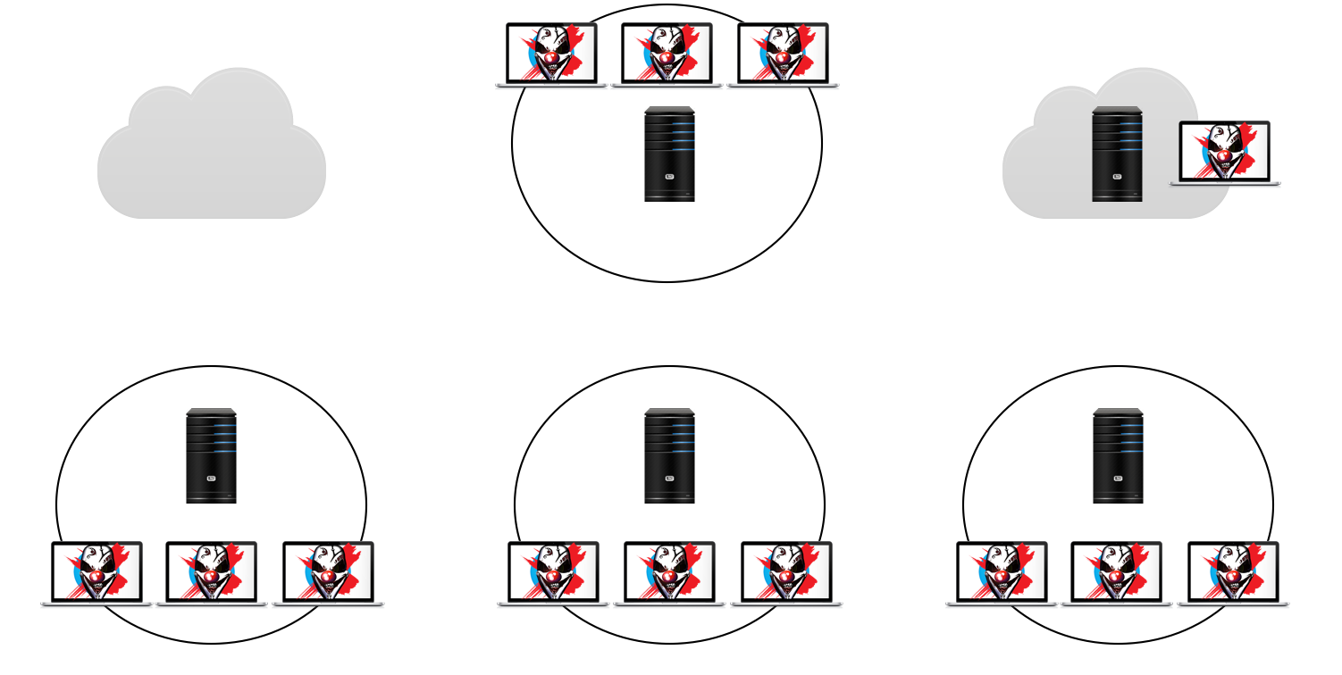
Common Architecture: Botnet
ORG 1
Bots
C&C Server
Cloud DC
C&C Server
ORG 2
ORG 4
Bots
Bots
ORG 3
Notes:
Botnet components
Botnet functional requirements
Botnet architectures
… now lets have a look at a typical Active Directory Architecture and look for similaries

Slide 17
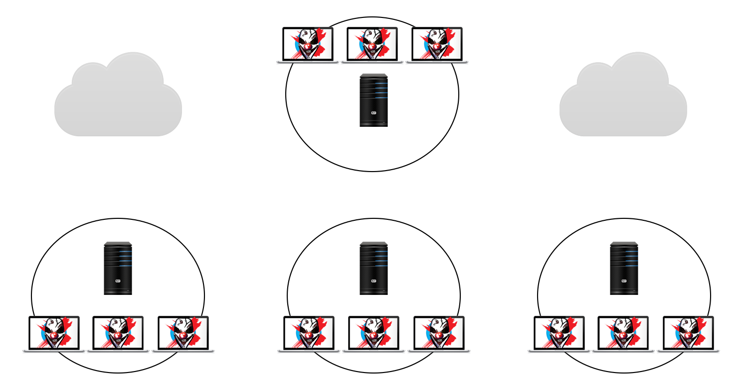
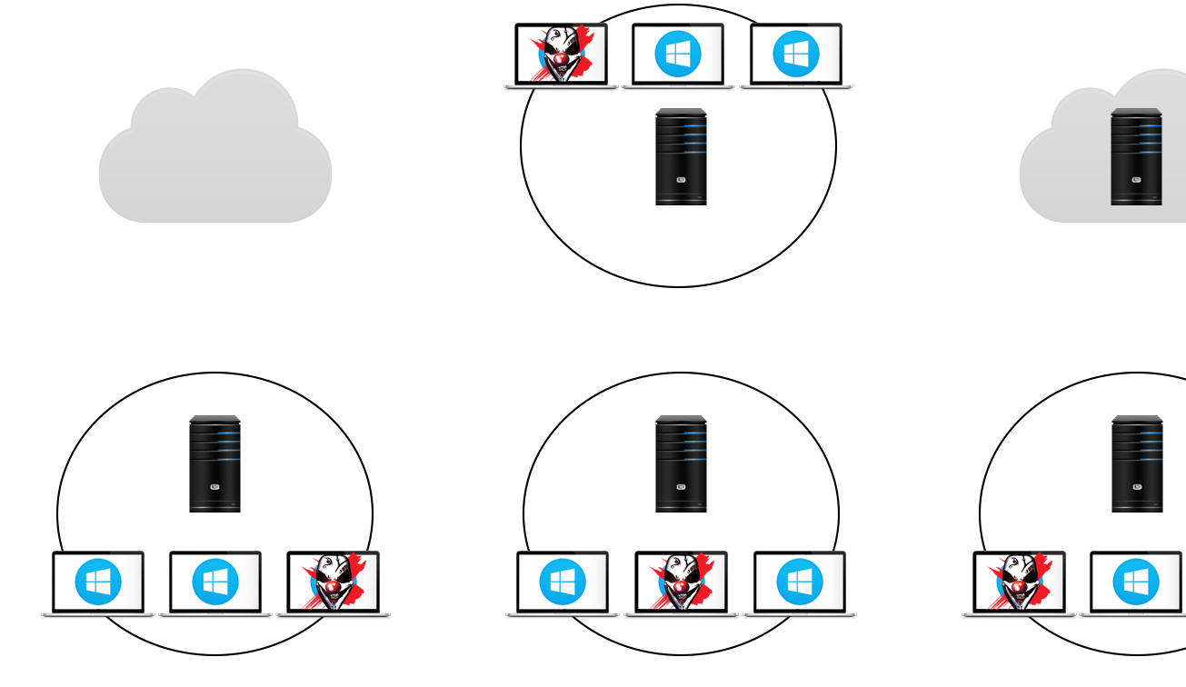
Active Directory Botnet Architecture
DMZ
Servers
Cloud DC
Domain
Controller
WAN 1
WAN 2
Endpoints
Servers
Management Zone
Notes:
Combine the botnet and AD architectures to create the AD Botnet

Slide 18
Active Directory as a suitable C2 channel
AD is a central authentication and access control point for organizations
All end user devices need connectivity to AD for authentication
All servers (or most) need connectivity to AD for authentication
This means that AD is a central connectivity point for all systems
This introduces the capability to bypass all network-layer security using AD
All users can (by default) write data into their own account attributes
When AD integrates with Azure AD, then direct remote controls is possible

Slide 19
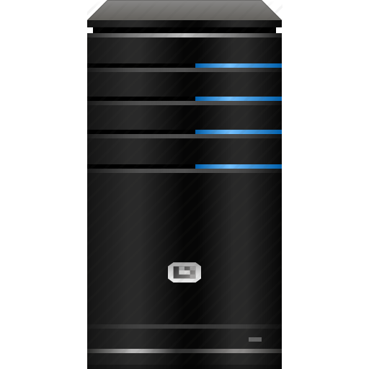
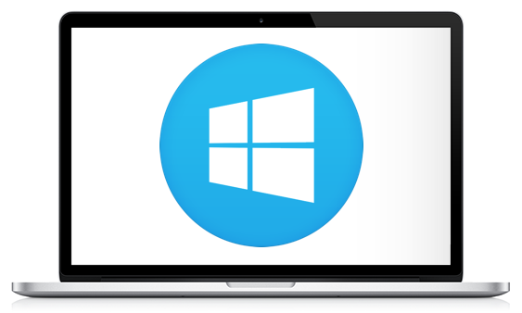
How does the AD Botnet Work?
Domain
Controller
AD Botnet
Controller
AD Botnet
Bot
ADWS (9389/tcp)
AD Web Service
LDAP (389/tcp)
Auth: Kerberos
Notes:
High level overview of AD Botnet structure and operation
Translating botnet functionality into Active Directory
- AD Botnet Controller -> DC: ADWS / LDAP -> AD Bot
Port 9389/tcp - Active Directory Web Services (ADWS)
Port 389/tcp – LDAP

Slide 20
AD Standard User Attributes
Domain Controller
Standard User Attributes
givenName
distinguishedName
instanceType
whenCreated
whenChanged
displayName
uSNCreated
info
memberOf
uSNChanged
homePostalAddress
name
objectGUID
userAccountControl
badPwdCount
codePage
countryCode
badPasswordTime
lastLogoff
lastLogon
pwdLastSet
primaryGroupID
objectSid
accountExpires
logonCount
sAMAccountName
sAMAccountType
userPrincipalName
ipPhone
objectCategory
dSCorePropagationData
mS-DS-ConsistencyGuid
lastLogonTimestamp
… many more
AD Botnet
Controller
AD Botnet
Bot
Notes:
Description of AD attributes

Slide 21
Abusing AD Standard User Attributes
Domain Controller
Key User Attribute Sizes
Binary Attributes
mSMQSignCertificates
thumbnailPhoto
userSMIMECertificate
userCert
registeredAddress
String Attributes
postalAddress
homePostalAddress
wWWHomePage
info
StreetAddress
street
primaryTelexNumber
st
ipPhone
(1 MB)
(100 KB)
(32 KB)
(32 KB)
(4 KB)
(4 KB)
(4 KB)
(2 KB)
(1 KB)
(1 KB)
(1 KB)
(64 bytes)
(64 bytes)
(64 bytes)
AD Botnet
Controller
AD Botnet
Bot

Slide 22
Abusing AD Standard User Attributes
ipPhone (64 bytes)
Botnet GUID
AD Botnet
Controller
Domain
Controller
AD Botnet
Bot
Info (1 KB)
Control Channel
homePostalAddress (4 KB)
Command Output
mSMQSignCertificates (1 MB)
File Transfers

Slide 23
Bot Registration Process
ipPhone (Botnet GUID)
AD Botnet GUID stored in ipPhone attribute
Enables bots to search AD to identify other members of the AD Botnet
homePostalAddress (Command Output)
This attribute is used to return the Command Output to the calling bot
This attribute is simply initialized to a known value
The attribute used for the “Command Output” is configurable

Slide 24
Bot Registration Process
Info Attribute (Control Channel)
<Username>:<Hostname>:<BotState>:<DstUser>:<DstHost>:<CommandID>:<Cmd>
Username: User the bot is running as (eg, “staff1”)
Hostname: Host the bot is running on (eg, “WIN-15PSMN6GMS4”)
BotState: Current State or Function: Wait, Ack, RunCmd, GetFile, SendShell
DstUser: Destination user to run the command as
DstHost: Destination host to run the command on
CommandID Unique command ID to allow tracking of different commands
Cmd AD Botnet command to execute
Example: staff1 : WIN122 : RunCmd : staff2 : WIN184 : 1603000 : base64(ipconfig)

Slide 25
Bot Registration Process
ipPhone (Botnet GUID)
dbc806eb-....-5d0b2b2000e2
AD Botnet
Controller
Domain
Controller
AD Botnet
Bot
Info (Control Channel)
staff1:WIN122:Wait:None:
None:None:None
homePostalAddress (Cmd Out)
1
Set AD Botnet GUID
Initialise status
Initialise cmd output

Slide 26
List All Bot Details
AD Botnet Controller
AD Botnet GUID stored in “ipPhone” attribute
Search AD accounts where the “ipPhone” attribute contains the AD Botnet GUID
Retrieve “info” attribute of each Bot
Display User, Host and Status details of each Bot

Slide 27
List All Bot Details
ipPhone (Botnet GUID)
dbc806eb-....-5d0b2b2000e2
ipPhone (Botnet GUID)
dbc806eb-....-5d0b2b2000e2
AD Botnet
Controller
Domain
Controller
ipPhone (Botnet GUID)
dbc806eb-....-5d0b2b2000e2
AD Botnet
Bot
Info (Control Channel)
staff1:WIN122:Ack:staff2:
WIN184:1603000:RunCmd
Info (Control Channel)
staff2:WIN122:Ack:staff2:
WIN184:1603000:RunCmd
Info (Control Channel)
staff3:WIN122:Ack:staff2:
WIN184:1603000:RunCmd
Search Botnet GUID
Get each Bot’s status

Slide 28
Send Command to Bot
AD Bot Controller
Bot Master selects the Bot to run the command on
Reads a command to be executed on the Bot
Generates a unique Command ID for tracking
Updates the info Attribute status to “RunCmd” and Cmd field to contain base64 command
Username: staff2
Hostname: WIN-Q84272PAIQD (Controller Hostname)
BotState: RunCmd
DstUser: staff3
DstHost: WIN-R3RCIAMC2AF (Target Bot Hostname)
CommandID 4723000
Cmd aQBwAGMAbwBuAGYAaQBnAA== … base64(ipconfig)
Polls the target Bot’s “info” attribute for an “Ack” status to acknowledge receipt of the cmd

Slide 29
Send Command to Bot
AD Bot
Search AD accounts and retrieves “info” attribute of each Bot
Checks if the “DstUser” and “DstHost” fields match itself
Checks the “BotState” field for the feature to carry out (RunCmd)
Base64 decodes the “Cmd” field and runs the command
Updates its own “info” attribute status to “Ack” to acknowledge receipt of the command
AD Bot Controller
Updates its own “info” attribute status to “SendOut” so the Bot knows it is ready

Slide 30
Send Command to Bot
AD Bot
Base64 encodes command output
Saves encoded command output into its “homePostalAddress” attribute
Once received, updates its status to be “Complete”
AD Bot Controller
Updates its own “info” attribute to acknowledge receipt of the command output
Decodes the base64 and displays the command output
The “Interactive Shell” basically loops around this process to simulate a shell.

Slide 31
Send Command to Bot
ipPhone (Botnet GUID)
dbc806eb-....-5d0b2b2000e2
AD Botnet
Controller
Domain
Controller
AD Botnet
Bot
Info (Control Channel)
staff1:WIN122:Ack:staff2:
WIN184:1603000:RunCmd
(1) Update Controller Bot status with command
homePostalAddress (Cmd Out)
1
(2) Search Botnet GUID and check if destination is me.

Slide 32
Send Command to Bot
ipPhone (Botnet GUID)
dbc806eb-....-5d0b2b2000e2
AD Botnet
Controller
Domain
Controller
AD Botnet
Bot
Info (Control Channel)
staff1:WIN122:SendOut:staff2:WIN184:1603000:1
(4) Request the command output
homePostalAddress (Cmd Out)
1
(3) Decode command string and acknowledge receipt via Info

Slide 33
Send Command to Bot
ipPhone (Botnet GUID)
dbc806eb-....-5d0b2b2000e2
AD Botnet
Controller
Domain
Controller
AD Botnet
Bot
Info (Control Channel)
staff1:WIN122:SendOut:staff2:WIN184:1603000:1
(6) Decode command output and display
homePostalAddress (Cmd Out)
CldpbmRvd3MgSVAgQ29uZmlndXJhdGlvbgoKCkV0aGVyb …
(5) Send command output then set status as complete

Slide 34
Download File from Bot
AD Bot Controller
Specify the file path to download from and where to save the file
Status updated for the destination host and instruction “SendFile” and Base64 encoded path of the file to download in the “Cmd” field
AD Bot
Repeats a similar process to the command execution
Difference is that the file is returned in the “mSMQSignCertificates” attribute (1 MB)

Slide 35
Download File from Bot
ipPhone (Botnet GUID)
dbc806eb-....-5d0b2b2000e2
AD Botnet
Controller
Domain
Controller
AD Botnet
Bot
Info (Control Channel)
staff1:WIN122:SendFile:staff2:WIN184:1603001:QwA6AF …
mSMQSignCertificates (Files)
CldpbmRvd3MgSVAgQ29uZmlndXJhdGlvbgoKCkV0aGVybmV0IGFkYXB0ZXIgTG9jYWwgQXJlYSBDb25uZWN0aW9uO …
(1) Instruct the Bot to send a specific file
(2) Sends the file via the mSMQSignCertificates attribute (1 MB)

Slide 36
Live Demo
Register Bots
List all active Bots
Remotely execute a command on a Bot
Gain an interactive shell on a Bot
Download a file from a Bot

Slide 37
Remote Command & Control Options
Microsoft provide an Azure cloud-hosted API into your Active Directory known as “GraphAPI”
This lets you interact with your AD from the Internet with any standard user account!
Azure AD doesn’t sync attributes back to your on-premise AD … or does it?
Your on-premise AD does sync attributes out to Azure AD … Data Exfiltration!
AD Botnet has a feature “Xfiltrate Data”

Slide 38
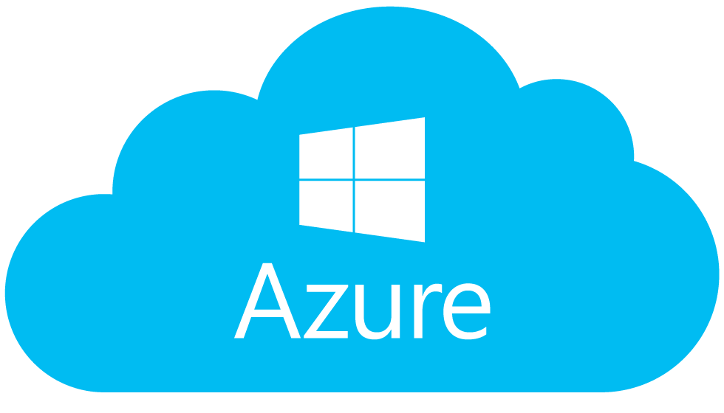
Xfiltrate Data
AD Botnet
Controller
GraphAPI
AD Botnet
Control Instructions
AD Sync
to/from Azure
Domain
Controller
AD Botnet
Bot
AD Botnet
Bot
Notes:
High level overview of AD Botnet structure and operation
Translating botnet functionality into Active Directory
- AD Botnet Controller -> DC: ADWS / LDAP -> AD Bot
Port 9389/tcp - Active Directory Web Services (ADWS)
Port 389/tcp – LDAP

Slide 39
Live Demo
Data Exfiltration via Azure AD / GraphAPI
AD Botnet pushes data into an attribute
AD Sync’s to Azure AD
Authenticate as standard user to GraphAPI
List the user attributes
Extract the data

Slide 40
Remote Command & Control Options
What other options do we have?
AD Botnet Bind TCP Handler
Setup a local bind handler on the bot (in DMZ)
Connect from a system on the internet
Tunnel shell through AD to an internal bot
AD Botnet Reverse TCP Handler
Connect out to a system on the internet
Tunnel shell through AD to an internal bot

Slide 41
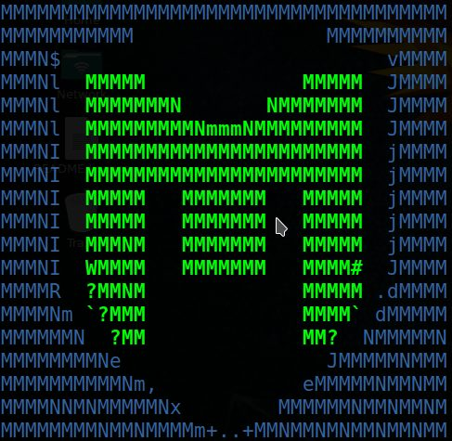
ADBN Bind TCP Handler
Metasploit
ADBN
Controller
Domain
Controller
ADBN
Bot
Remote
Victims
Notes:
High level overview of AD Botnet structure and operation
Translating botnet functionality into Active Directory
- AD Botnet Controller -> DC: ADWS / LDAP -> AD Bot
Port 9389/tcp - Active Directory Web Services (ADWS)
Port 389/tcp – LDAP

Slide 42
ADBN Reverse TCP Handler
Metasploit
ADBN
Controller
Domain
Controller
ADBN
Bot
Remote
Victims
Notes:
High level overview of AD Botnet structure and operation
Translating botnet functionality into Active Directory
- AD Botnet Controller -> DC: ADWS / LDAP -> AD Bot
Port 9389/tcp - Active Directory Web Services (ADWS)
Port 389/tcp – LDAP

Slide 43
Live Demo
AD Botnet Reverse TCP Handler
Connect out to a system on the internet
Tunnel shell through AD to an internal bot
AD Botnet Bind TCP Handler
Setup a local bind handler on the bot (in DMZ)
Connect from a system on the internet
Tunnel shell through AD to an internal bot

Slide 44
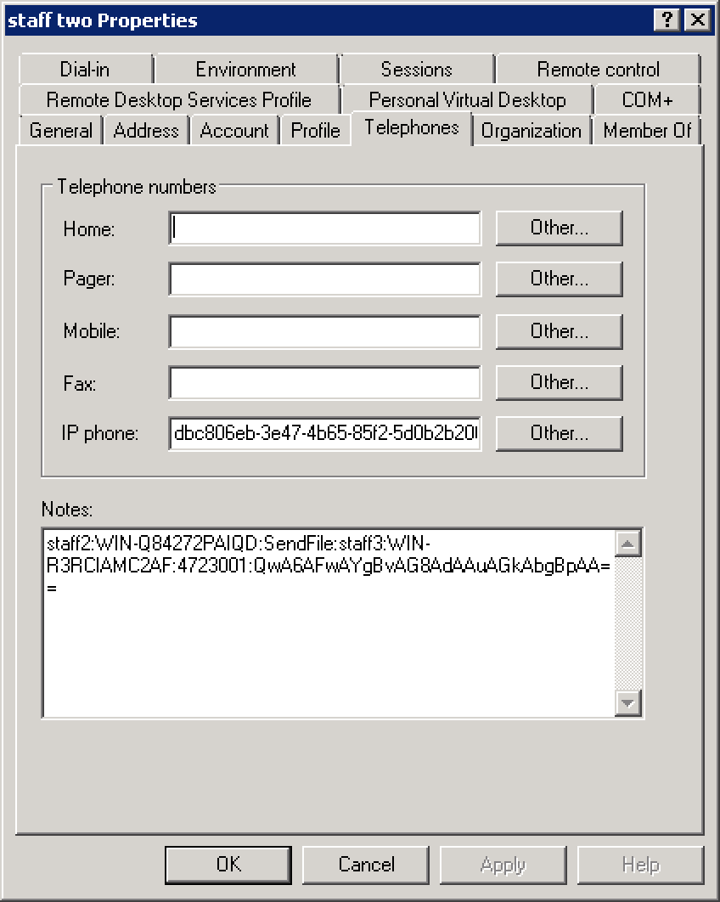
Mitigating the AD Botnet Attack
Separating your domain into different forests based on security roles. This prevents users in one domain bypassing network filtering to escalate their privileges.
Noticing odd values in fields …
Monitoring regular changes of “Personal Information” attributes

Slide 45
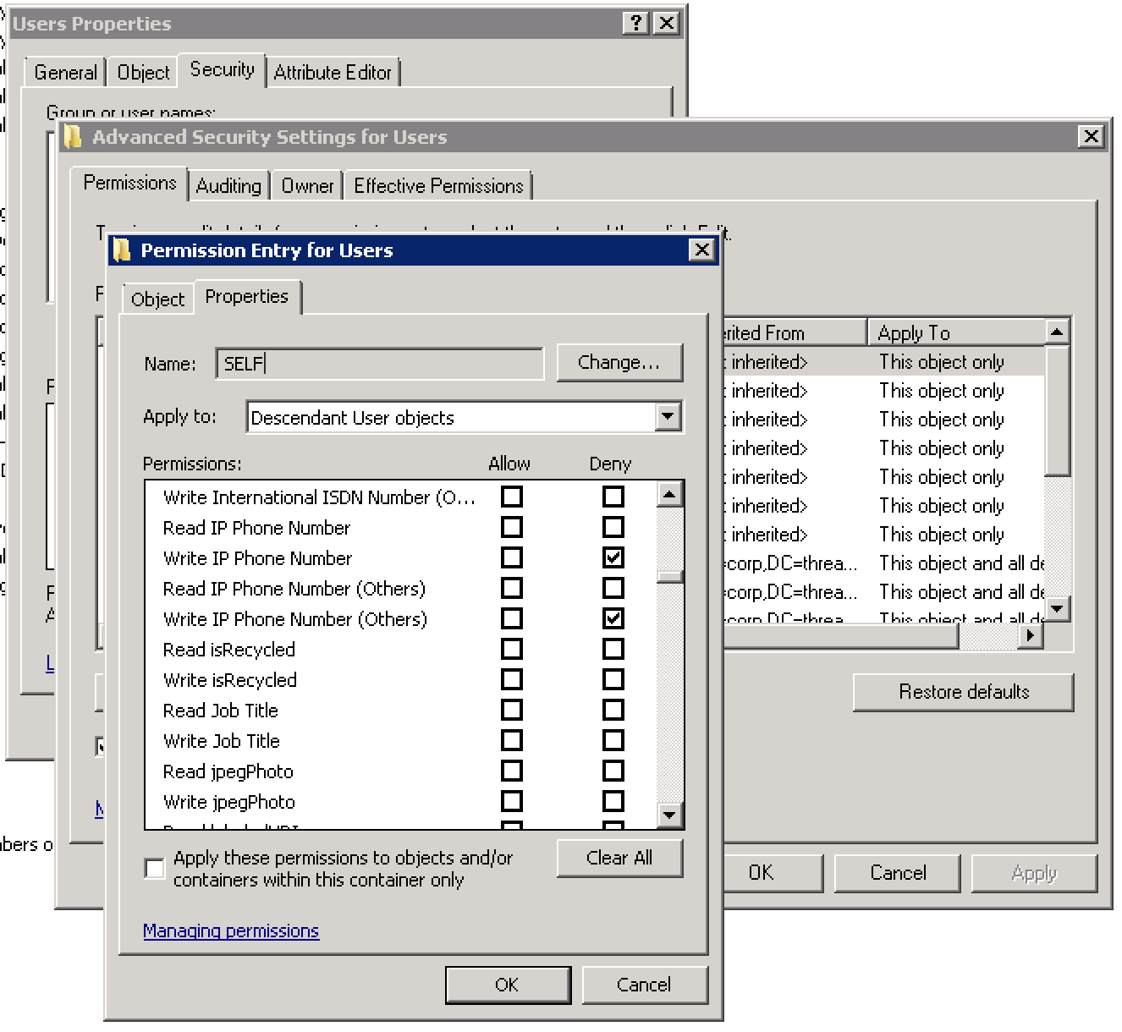
Mitigating the AD Botnet Attack
Locking down permissions for standard users to update their own “Personal Information” attributes

Slide 46
Credits / References
@harmj0y
http://www.harmj0y.net/blog/powershell/command-and-control-using-active-directory/
Threat Intelligence
The AD Botnet concept was thought up internally at Threat Intelligence by Ty Miller in 2014 and investigated at the time to identify if the attack existed, which resulted in no other references.
Development of the AD Botnet began in late 2016 by Paul Kalinin of Threat Intelligence
We came across the above blog post in Q2 of 2017
We found that different approaches were used for the communications, both using similar AD attributes, but Harmj0y injects PowerShell into a single attribute, whereas the AD Botnet uses multiple attributes for botnet registration, command channel, data channel, file transfers, and socket communication data transfer.
We had planned to contact Harmj0y and mention his contribution the presentation, which was missed in the understandably busy preparations leading up to the presentation
Apologies @harmj0y and thanks for sharing your work!

Slide 47
Credits / References
The AD Botnet includes a range of additional features including:
Multi-Botnet Support
Bot Registration
Multi-Attribute Control Channel
Multi-Attribute Data Channels
Individual Bot Single Command Execution
Simulated Interactive Bot Command Shell
AD Botnet Bind Handler (Socket-based Bot Communication and Remote Port Forwarding)
AD Botnet Reverse TCP Handler (Reverse Socket-based Bot Communication and Remote Port Forwarding)
Azure AD and Graph API Integration:
Azure AD and Graph API One-Way Remote Data Egress
Azure AD and Graph API Two-Way Remote AD Botnet Command and Control including “Remote Sockets”
(when Azure AD Connect is used)
… and more features to come!

Slide 48
The Active Directory Botnet
Thank you for attending
Ty Miller
Managing Director
Threat Intelligence Pty Ltd
ty.miller@threatintelligence.com
www.threatintelligence.com
Paul Kalinin
Senior Security Consultant
Threat Intelligence Pty Ltd
paul.kalinin@threatintelligence.com
www.threatintelligence.com

